Slide 1
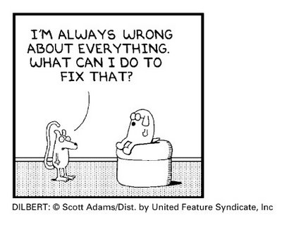
Why Model?
Make predictions or forecasts where we don’t have data

Slide 2
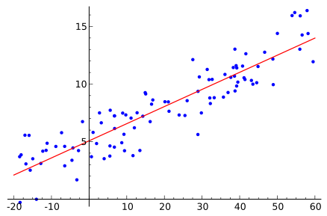
Linear Regression
wikipedia

Slide 3
Activity
Use the “discussion sheet” to create a linear regression chart on the white board and on the discussion sheet.

Slide 4
Definitions
Horizontal axis: Used to create prediction
Vertical axis: What we are trying to predict
  Independent variable
  Explanatory variable
  Covariate?
  Predictor variable
  Control variable
  Typically a raster
  Examples:
    Temperature, aspect, SST, precipitation
  Dependent variable
  Response variable
  Measured value
  Explained
  Outcome
  Typically an attribute of points
  Examples:
    Height, abundance, percent, diversity, …

Slide 5
Modeling Process
Observe
Select
Model
Define Theory/
Type of Model
Estimate
Parameters
Design
Experiment
Evaluate the Model
Collect Data
Publish Results
Qualify Data

Slide 6
Definitions
The Model – the specific algorithm that predicts our dependent variable values
Parameters – the values in the model we estimate (i.e. a/b, m/b for linear regression)
  Aka, coefficients or “estimated parameters”
Performance measures – show how well the model fits the data
  Aka, descriptive stats

Slide 7
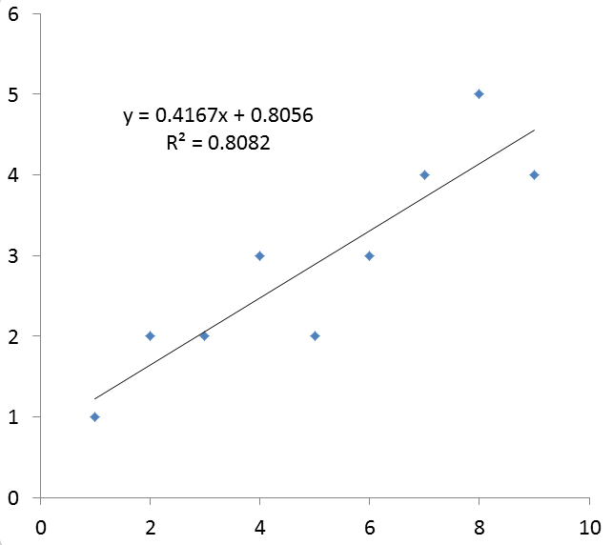
Parameter Estimation
Excel spreadsheet
X, Y columns
Add “trend line”
Notes:
Number of samples
Max height
Minimum height
Height of a bounce

Slide 8
Linear Regression: Assumptions
Predictors are error free
Linearity of response to predictors
Constant variance within and for all predictors (homoscedasticity)
Independence of errors
Lack of multi-colinearity
Also:
  All points are equally important
  Residuals are normally distributed (or close).

Slide 9


Multiple Linear Regression

Slide 10



Normal Distribution
$$μ=mean$$
$$σ=standard deviation$$
To negative
infinity
To positive infinity
68.2%
95.4%
99.7%

Slide 11
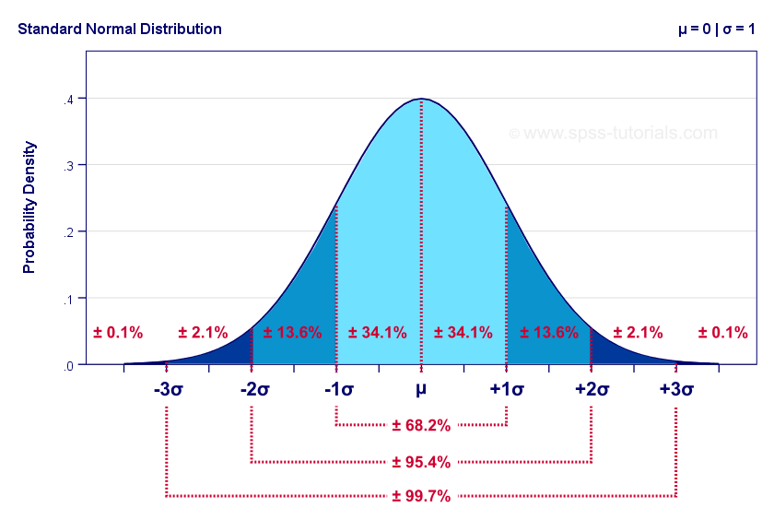
https://www.spss-tutorials.com/

Slide 12
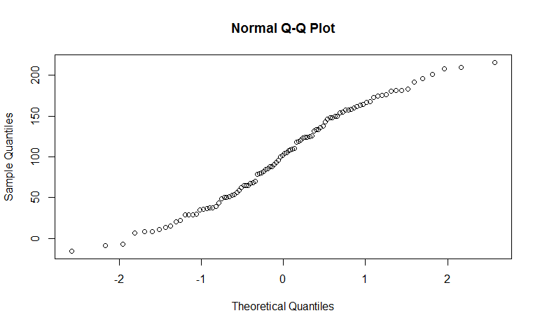
Linear Data Fitted w/Linear Model
Should be a diagonal line for normally distributed data

Slide 13
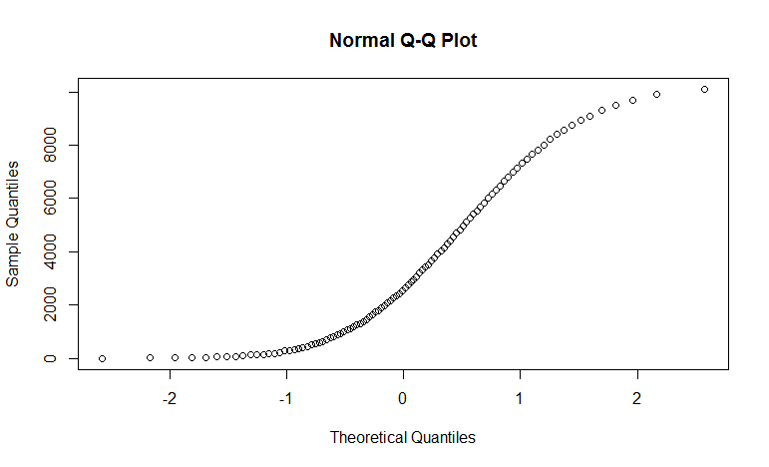
Non-Linear Data Fitted with a Linear Model
This shows the residuals are not normally distributed

Slide 14
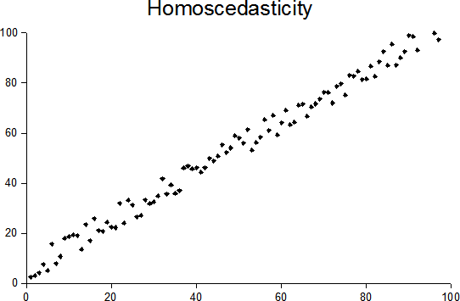
Homoscedasticity
Residuals have the same normal distribution throughout the range of the data

Slide 15
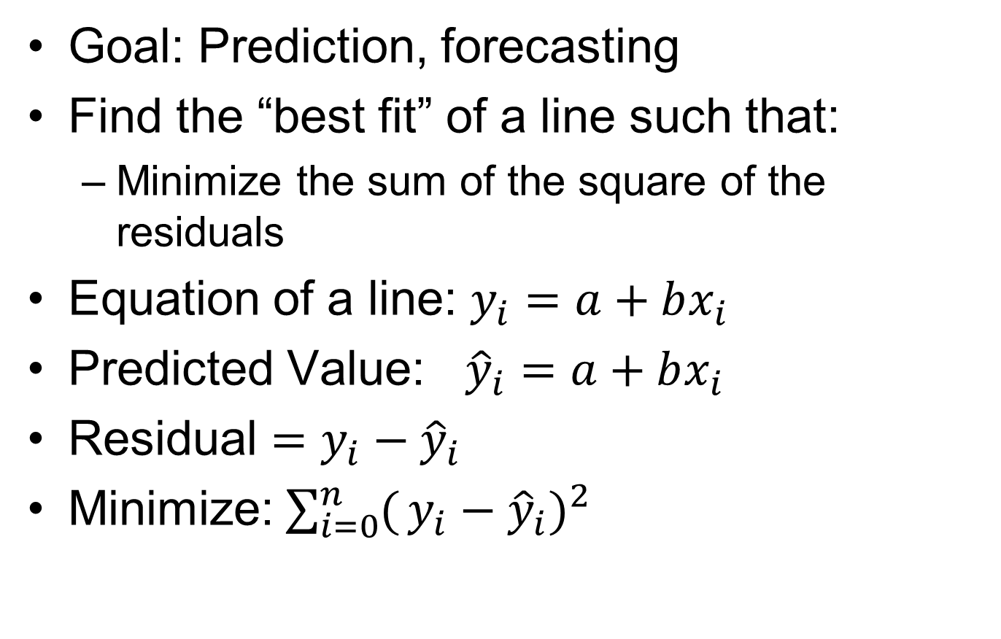
Ordinary Least Squares

Slide 16
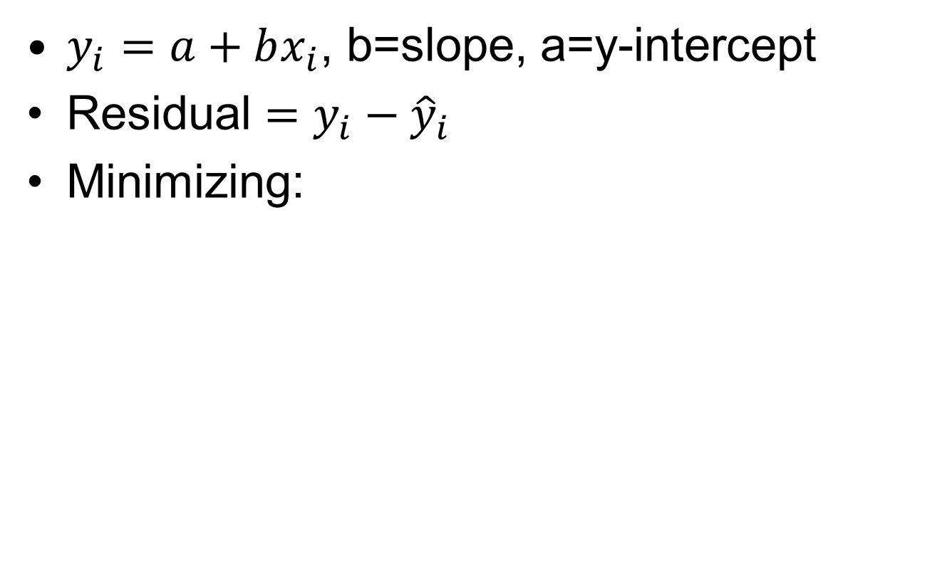
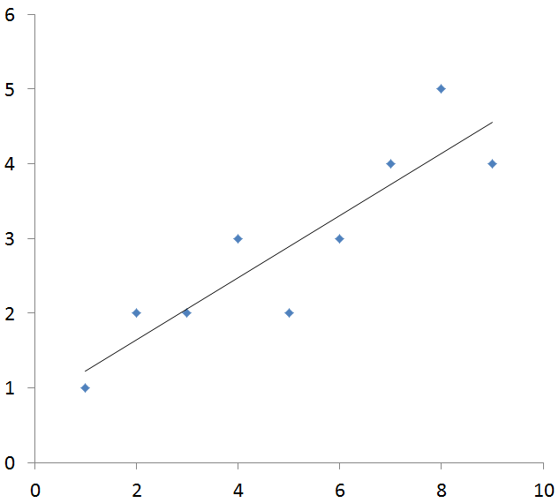

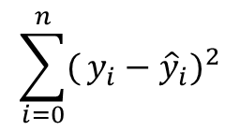

Linear Regression
Residual

Slide 17
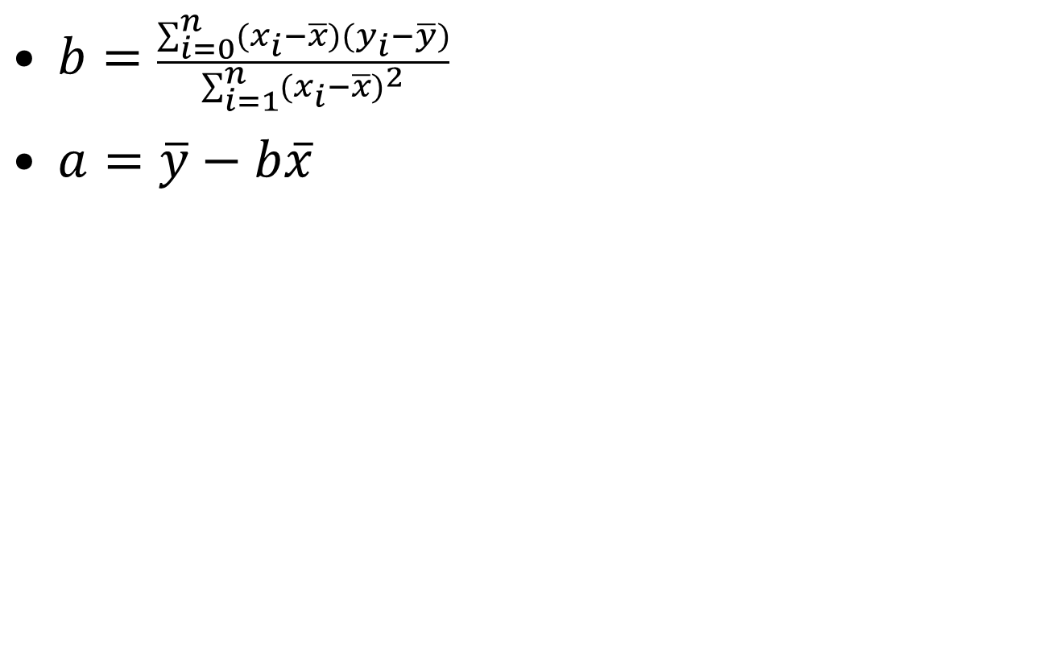


Parameter Estimation

Slide 18
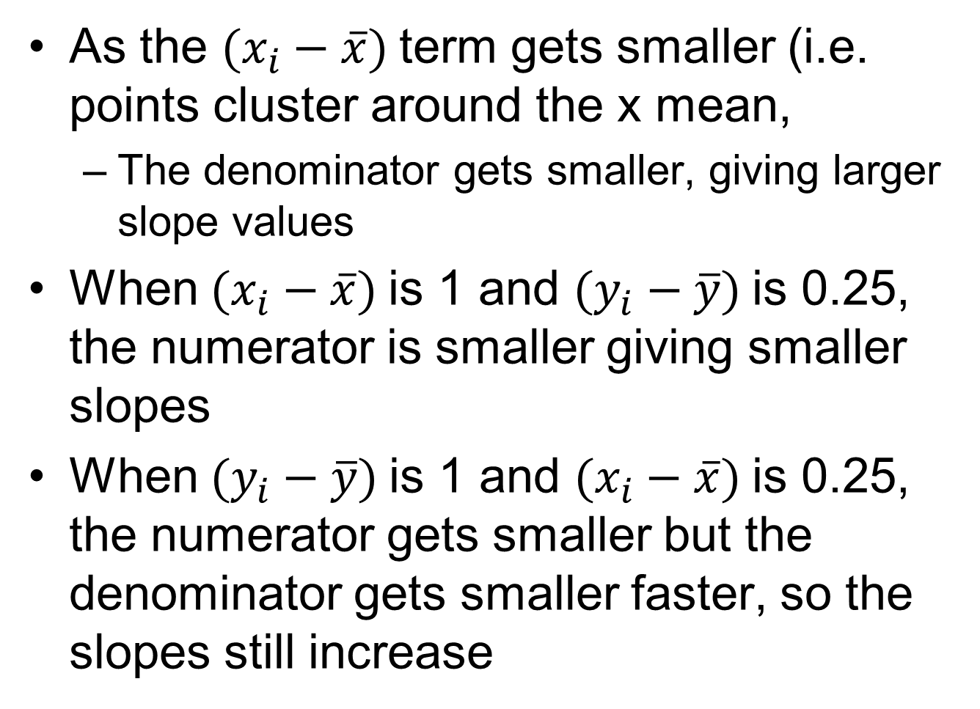
Explanation
As the $(x_{i}−\overline{x})$term gets smaller (i.e. points cluster around the x mean,
  The denominator gets smaller, giving larger slope values
When $(x_{i}−\overline{x})$is 1 and $(y_{i}−\overline{y})$is 0.25, the numerator is smaller giving smaller slopes
When $(y_{i}−\overline{y})$is 1 and $(x_{i}−\overline{x})$is 0.25, the numerator gets smaller but the denominator gets smaller faster, so the slopes still increase

Slide 19

Evaluate The Model
Goodness of Fit: $R^{2}$
  Fit of the model to the data
Confidence Intervals
Statistical Significance: p-values

Slide 20
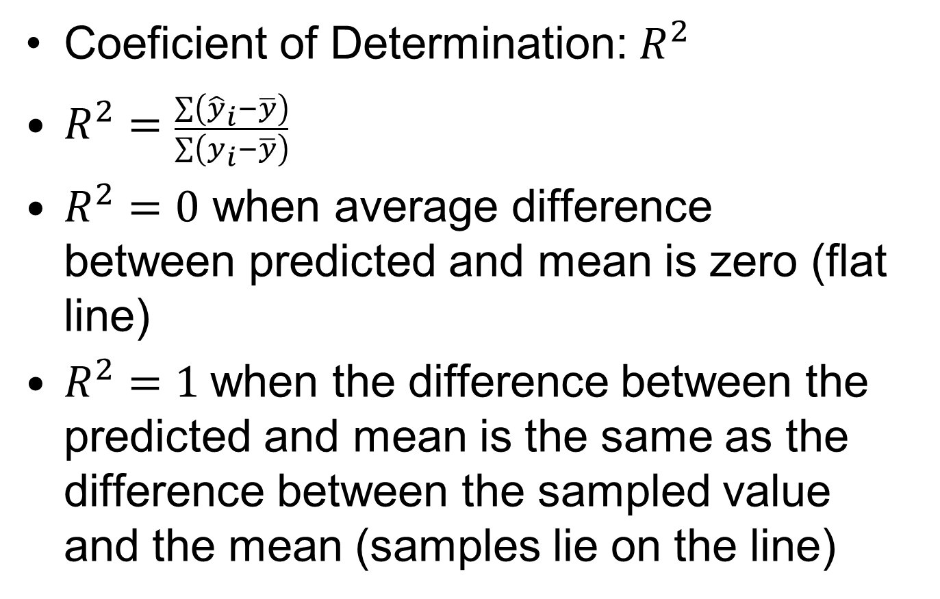
“Goodness of fit”

Slide 21


Slide 22


Slide 23
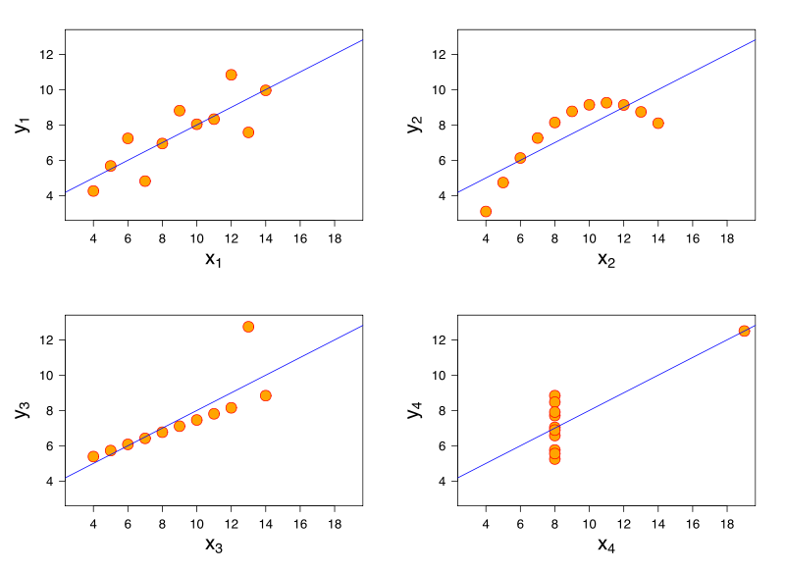
Good Model?
Anscombe's quartet, nearly identical descriptive statistics
Notes:
- What is the models “predictive power”

Slide 24
p-value: Significance?
H0 – Null hypothesis (flat line)
Hypothesis – Regression line not flat
The smaller the p-value, the more evidence we have against H0
  The more evidence our hypothesis is true
  Measure of how likely we are to get a certain sample result or a result “more extreme,” assuming H0 is true
  The chance the relationship is random
http://www.childrensmercy.org/stats/definitions/pvalue.htm
Notes:
The problem with “disproving the null hypothesis” is that is it commonly misunderstood
The problem with “p” values is that they are overused, especially for applied research

Slide 25
Confidence Intervals
95 percent of the time, values will fall within a 95% confidence interval
Methods:
  Moments (mean, variance)
  Likelihood
  Significance tests (p-values)
  Bootstrapping
Note that we also look at confidence intervals for the model (and mean of a distribution)

Slide 26
Two Approaches
Hypothesis Testing
  Is a hypothesis supported or not?
  What is the chance that what we are seeing is random?
Which is the best model?
  Assumes the hypothesis is true (implied)
  Model may or may not support the hypothesis
Data mining
  Discouraged in spatial modeling
  Can lead to erroneous conclusions

Slide 27
Model Evaluation
Parameter sensitivity
Ground truthing
Uncertainty in data AND predictors
  Spatial
  Temporal
  Attributes/Measurements
Alternative models
Alternative parameters

Slide 28
Model Evaluation?

Slide 29
Robust models
Domain/scope is well defined
Data is well understood
Uncertainty is documented
Model can be tied to phenomenon
Model validated against other data
Sensitivity testing completed
Conclusions are within the domain/scope or are “possibilities”
See:https://www.youtube.com/watch?v=HuyMQ-S9jGs

Slide 30
Modeling Process II
Investigate
Select
Model
Estimate
Parameters
Evaluate the Model
Find Data
Publish Results
Qualify Data

Slide 31
Three Model Components
Trend (correlation)
  We have just been talking about these
Random
  “Noise” that is truly random or an effect on our data we do not understand (or are ignoring)
Auto-correlated
  Values that are correlated with themselves in space and/or time

Slide 32
First Law of Geography
"Everything is related to everything else, but near things are more related than distant things.“
  Geographer Waldo Tobler (1930-)
In our data, we may see patterns of spatial autocorrelation.

Slide 33
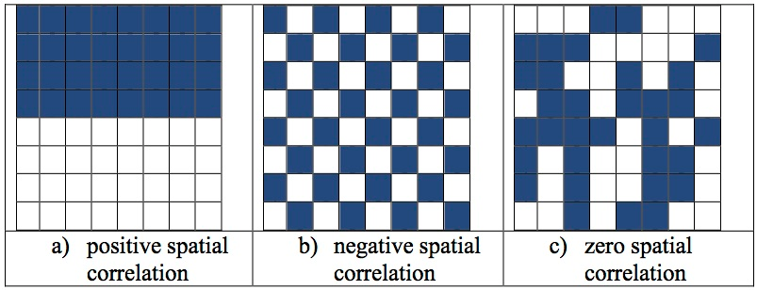
Measures of Auto-Correlation
Moran’s I – most common measure
  1 = perfect correlation
  0 = zero correlation
  -1 = negative correlation
https://docs.aurin.org.au

Slide 34
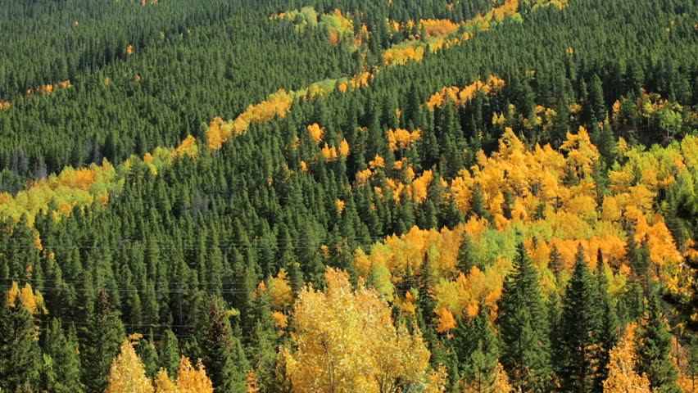
Patches of Aspen
http://www.shutterstock.com/

Slide 35
Process of Correlation Modeling
Find the trends that can be correlated with a known data set.
  Model and remove them.
Find any auto-correlation.
  Model and remove it?
What is left is the residuals (i.e. noise, error, random effect).
  Characterize them.

Slide 36
Research Papers
Introduction
  Background
  Goal
Methods
  Area of interest
  Data “sources”
  Modeling approaches
  Evaluation methods
Results
  Figures
  Tables
  Summary results
Discussion
  What did you find?
  Broader impacts
  Related results
Conclusion
  Next steps
Acknowledgements
  Who helped?
References
  Include long URLs

